Slide 1

User Interface Design contd.. (Chapter 11- by Roger S. Pressman)

Slide 2
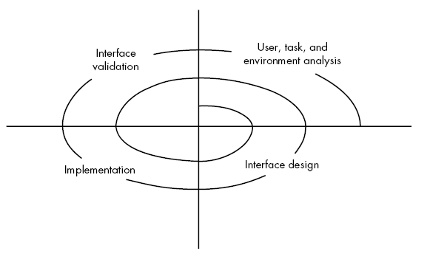
UI analysis & design Process
Iterative process – It uses the spiral process model
Four steps are:
Interface analysis
Interface design
Interface implementation/construction involves prototyping approach
Interface validation
Since its spiral model so these steps need to be processed again and again for design betterment.

Slide 3
UI analysis & design Process
User analysis:
Assess users’ profile who are going to use the system.
Assessment related to skill level, business perception
Define different user categories
Gather requirements for each category & understand system by each category perspective.

Slide 4
UI analysis & design Process
Interface design:
A set of interface objects and actions along with their screen representation that allows user to perform all tasks and fulfil the usability goals of the system.
Interface Construction/implementation:
Create prototype against a use case scenarios.

Slide 5
UI analysis & design Process
Interface validation:
Check if the system accommodates all variety of tasks?
Whether the system is easy to use & learn?
users’ acceptance of a system as useful tool
Now, we’ll cover each separately in detail

Slide 6
Interface Analysis
User Analysis:
Understand problem before designing the solution.
Understand users of the system,
the system goals (tasks),
the displayed content,
the environment in which tasks is conducted.
The mental image and the design model must converge.
Can be achieved by understanding the users and how they use the system

Slide 7
Interface Analysis
Information for system understanding can be obtained by:
User interviews
s/w team members met with end users to identify their needs and work culture.
Marketing & sales input
Take the market survey and check in how many ways the product could come handy.
Support input
Support staff takes feedback of the what work or what not. Which features are easy to use or not etc.

Slide 8
User Analysis questions for better user categorization
Are users trained professionals, technician, clerical, or manufacturing workers?
What level of formal education does the average user have?
Are the users capable of learning from written materials or have they expressed a desire for classroom training?
users expert typists / keyboard phobic?
age range of the user community?
User’s gender?
How are users compensated for the work they perform?
Working hours: normal office hours / until the job is done?
Software usage frequency ? (mostly/occasionally)
primary spoken language among users?
consequences if a user makes a mistake using the system?
Are users experts in the subject matter that is addressed by the system?
Are users interested in learning about the technology that sits behind the interface?

Slide 9
UI analysis & design Process
task analysis:
Detailed task analysis done after interface analysis.
The tasks that users will perform to accomplish system goals.
User environment analysis:
done to check if the current physical environment be able to cater the system needs?
Output: Analysis model for interface

Slide 10
Interface Analysis
Task Analysis & Modelling
answer the given questions the following questions …
Task identification in specific circumstances.
Tasks and sub tasks performed by user
sequence of work tasks—the workflow
Use-cases:
define basic interaction of actor and system
written using informal paragraphs.
Can be used to derive tasks, sub tasks and interfaces
Task elaboration:
Stepwise elaboration or task refinement of interactive tasks
Derive either manually or use a preexisting system to identify them
Object elaboration:
extract physical objects from system to define their classes and behavior
Workflow analysis defines how a work process is
How a work process is completed when several people (and roles) are involved
Shown using UML swim line diagram

Slide 11
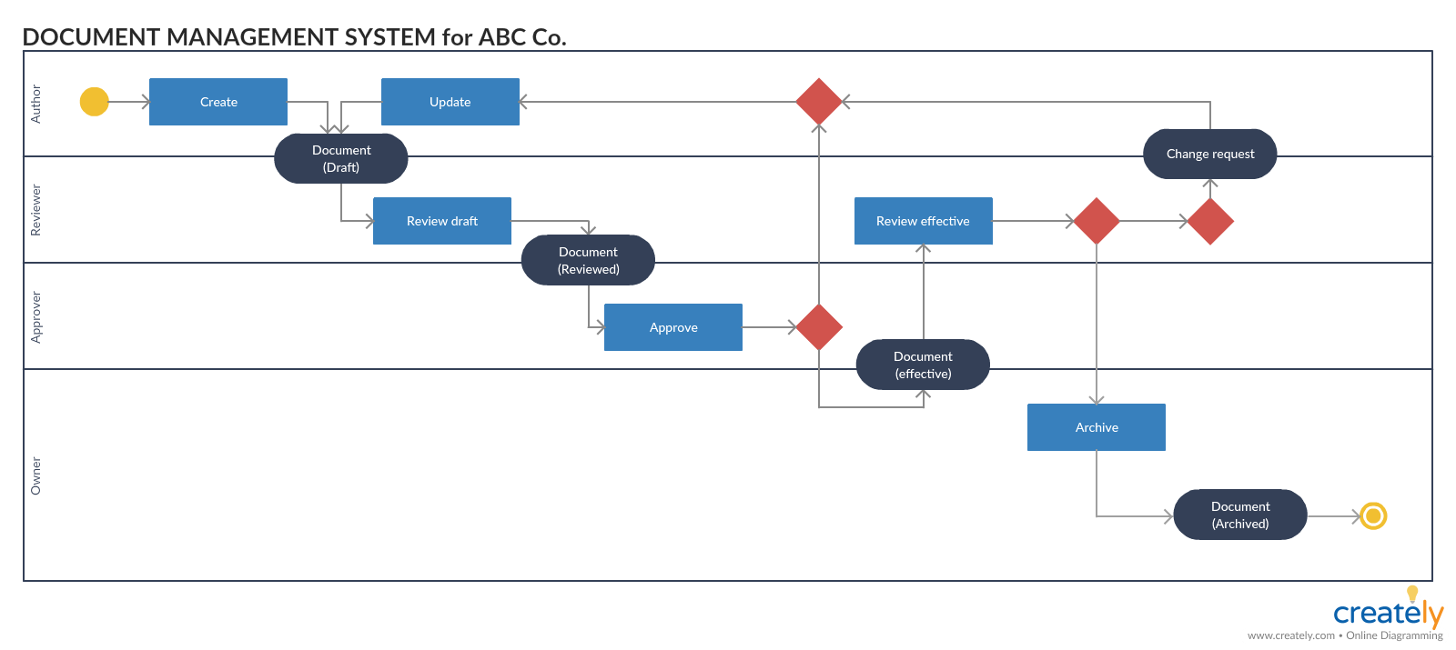
Interface Analysis
Task Analysis & Modelling
Swim line diagram

Slide 12
Interface Analysis
Analysis of Display Content
Format of the content
Aesthetics
Content displayed using stepwise refinement approach
Analysis of Physical Work Environment
Work environment should be helpful in proper operation and concentration .
Must co-relate with the designed software aesthetics.

Slide 13
Interface Design Steps
UI Design models state that:
Using information developed during interface analysis,
define interface objects (buttons, text fields, video etc.) and operations (tasks)
Define events (user actions) that will change the state of the UI.
Depict each interface state as it will actually look to the end-user. (using sketches).
Show how the user infer the System state from information provided through the interface.

Slide 14
Interface Design Steps
Apply interface design steps
Define the use-case:
Create the list of objects and actions
These objects & actions are categorized into different type.
Identify which are source (e.g., printer icon), target (e.g., paper) and application objects(e.g., screen, entity/db table).
Use UI design patterns
As specific deign pattern is formulated for a well bounded solution.
E.g., for a calendar UI, a Calendar Strip is created that allows to traverse in future dates, marking the current one.

Slide 15
Interface Design Steps
Design Issues
Some of the issues are:
System Response time
Help facilities
Error handling
Menu & command labelling

Slide 16
Interface Design Steps
Design Issue 1: System Response time
Primary complaint for almost every interactive system
Two characteristics:
Length: longer response times are not appreciated, led to user frustration
Variability: varying response time led to user confusion, like whether something went wrong at backend which is leading to a different response time than average response time.

Slide 17
Interface Design Steps
Design Issue 2: Help Facilitates
Online helpdesk
Detailed user manuals
Design issues while providing Help facilities
Help availability for all functionalities?
How will user demand help? (give menu for that or a function key mapped to that)
How help is presented? (via another window or a printed manual)
How to return to normal UI after consulting help

Slide 18
Interface Design Steps
Design Issue 3: Error Handling
Error messages & warnings are bad news to users when something went wrong.
Error message must be explanatory and should include some remedies for that (via hyperlinks)
A good error message includes:
Describe problem simply
Provide valuable advice
List the negative consequences of the error
Message must prompt visually using a color scheme that easily categorize it as an error.

Slide 19
Interface Design Steps
Design Issue 4: Menu & Command labeling
Different styles like command oriented arch and UI based arch.
Both are used frequently
How commands are assigned to each menu item so that it may run without UI as well.
Design Issue 5: Application Accessibility
UI should cater the needs of the physically challenged persons as well (like some sort of voice inputs could be accepted to facilitate handicapped)
Design Issue 6: internationalization
UI must target the global market
Follow global design standards & facilitate multiple languages.

Slide 20
Revised Interface Design Guidelines for a Web App
Anticipation
Application must depicts the user’s expected move.
E.g., software installation procedures are defined in a way to predict next step for users. They don’t need to search for the next work.
Communication
Application must show the status of an activity initiated by user.
E.g., file copying shown via progress bar
Consistency
The navigation controls, menu, icons, aesthetics should be consistent throughout the application
E.g., like yellow triangle shows warning signs use them for warning messages only.
Controlled autonomy
Revising the golden rule that says place user in control but restrict the controls as per the user’s role.
Enforce id and password for no go options.
Efficiency
Design of the application must work on user’s efficiency.
e.g., input the CNIC or hone no without space or hyphen will lead to less processing time at user end.

Slide 21
Revised Interface Design Guidelines for a Web App
Focus
The interface should help user stay focused and give the relevant options and data first
Fitts's law
Law—“The time to acquire a target is a function of the distance to the target and the size of the target.”
In interactive systems its important to complete tasks quickly so relevant options should be easily accessible and in larger size.
The important buttons should be made bigger to reduce accessibility time
And inter-related targets should be placed together to reduce time.
E.g., in Youtube, sound controls at bottom and near to video and subscribe button bigger
Latency reduction
Interface must do multitasking rather than kept user waiting for an operation to complete
e.g., display a progress bar to show the progress of the task like downloading
Show and animated visuals to keep user focused.

Slide 22
Revised Interface Design Guidelines for a Web App
Learnability
Minimize learning time by creating simple & intuitive designs
Maintain work product integrity
An interface should autosaved the user data
e.g., filling out long forms and loosing data in case of an error in an input field. This leas to frustration. So the data should be saved for all the correct fields.
Readability
All information presented should be readable by all age group users
Track state
Cookies can be used to track user activities so user may logout any time & can continue from the same state after logging in again
Visible navigation
Obvious navigation bars mentioned on every interface of the application.

Slide 23
Interface Design Workflow:
Derive and refine information from requirements
Develop rough layout sketch
Map user objective to actions (like Home, Contact, booking, facililities, etc….)
Create storyboard screen images for every interface
Refine layouts by improving aesthetics
Develop an activity diagram to show the design flow
Develop state diagrams to show changes in state after transitions
Describe interface layout for every state
Refine & review the model.

Slide 24
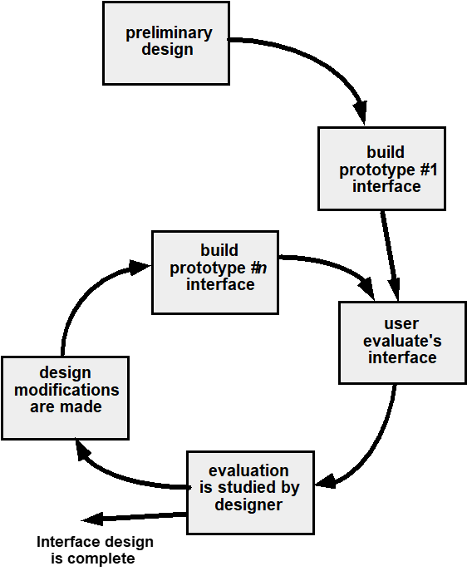
Interface Design Evolution:

